Slide 2

LIVE WEATHER
Submitted By:
Asim paudel(020-308)
Nabin dahal(020-347)
Arpan satyal(020-306)

Slide 3
contents
Introduction
Existing system
Developed system
Aim
Objectives
Advantages
Features
Tools and technologies used
System design
screenshots
Conclusion

Slide 4

Introduction
The proposed system provides global weather coverage
In this system the user can view weather for which they search for.
The system can track local and National weather.
The proposed system uses open weather API for searching the weather.

Slide 5

Existing system
Limited features
Limited location support
Adds

Slide 6

Developed system
Advanced features
Global location support
Add free

Slide 7
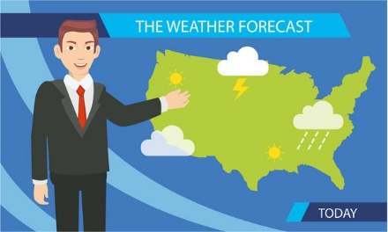
Aim
Long –term planning assistance
Travel and commute planning
Agricultural planning
Recreational and event planning

Slide 8
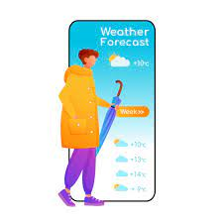
Objective
Provide accurate information to reduce weather related losses.
Offer location based forecast
Forecast future weather condition.
User friendly interface

Slide 9

Advantages
Instant access to current weather
Universal accessibility
Enhanced decision making

Slide 10

Features
Advanced UI customization
Weather news section
Automatic location based weather data
More features such as weather alert,feels like temperure,
Wind speed, radar map etc.

Slide 11

Tools and technologies
Description | type
Operating system | Windows 64-bit 2gb ram
Language | Html,css and js
IDE | Visual studio code
API | OPEN WEATHER API

Slide 12
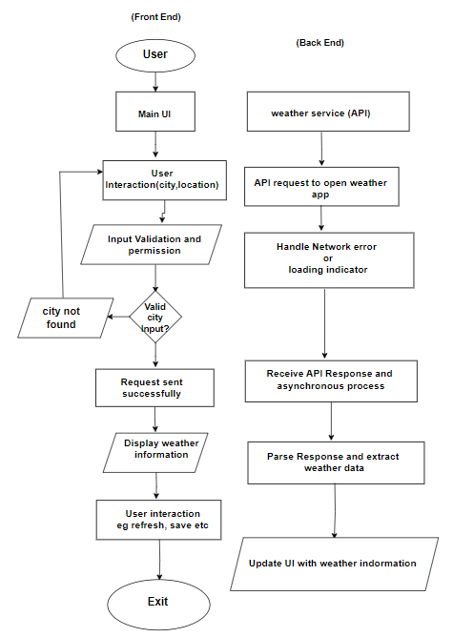
System Design:

Slide 13
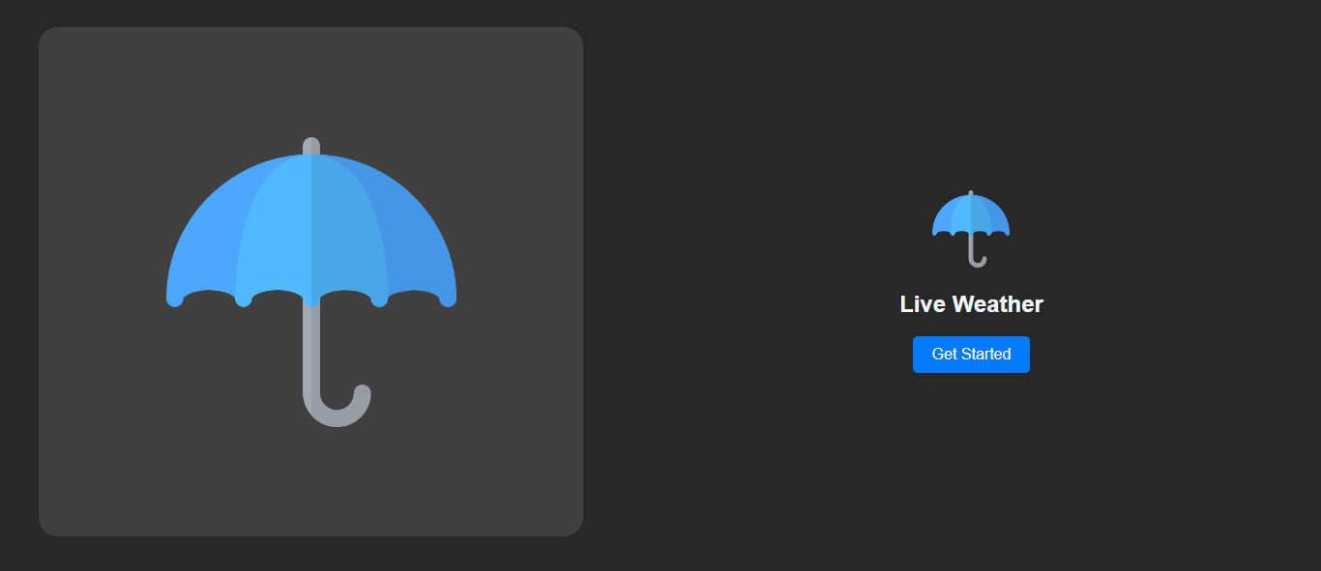

Slide 14
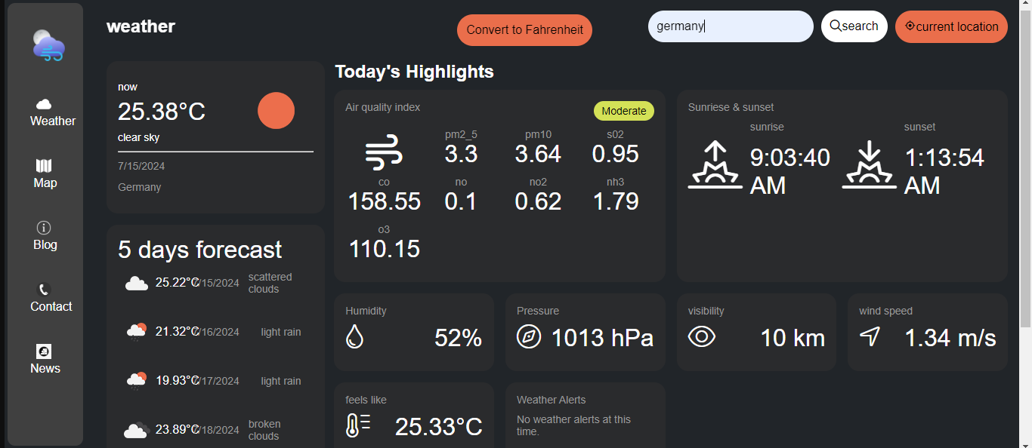

Slide 15
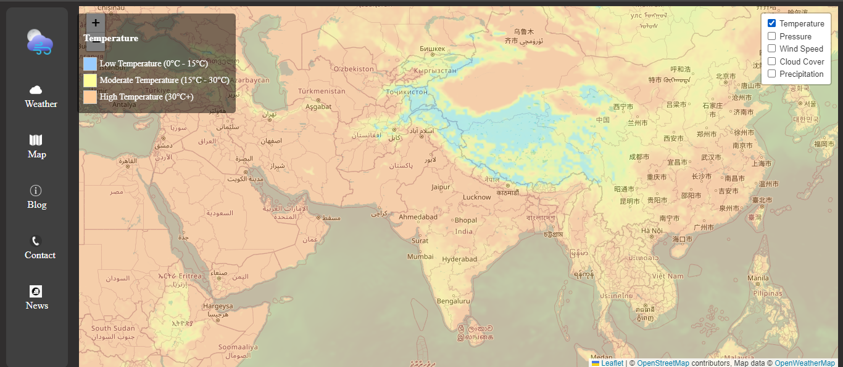

Slide 16
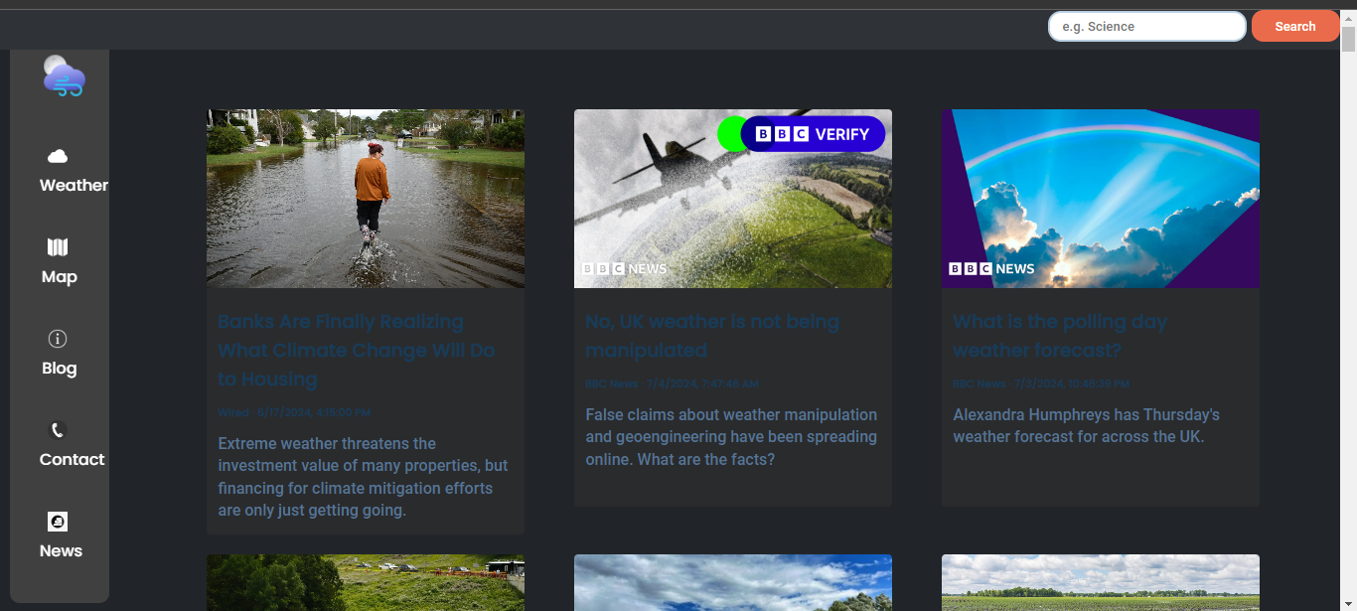

Slide 17
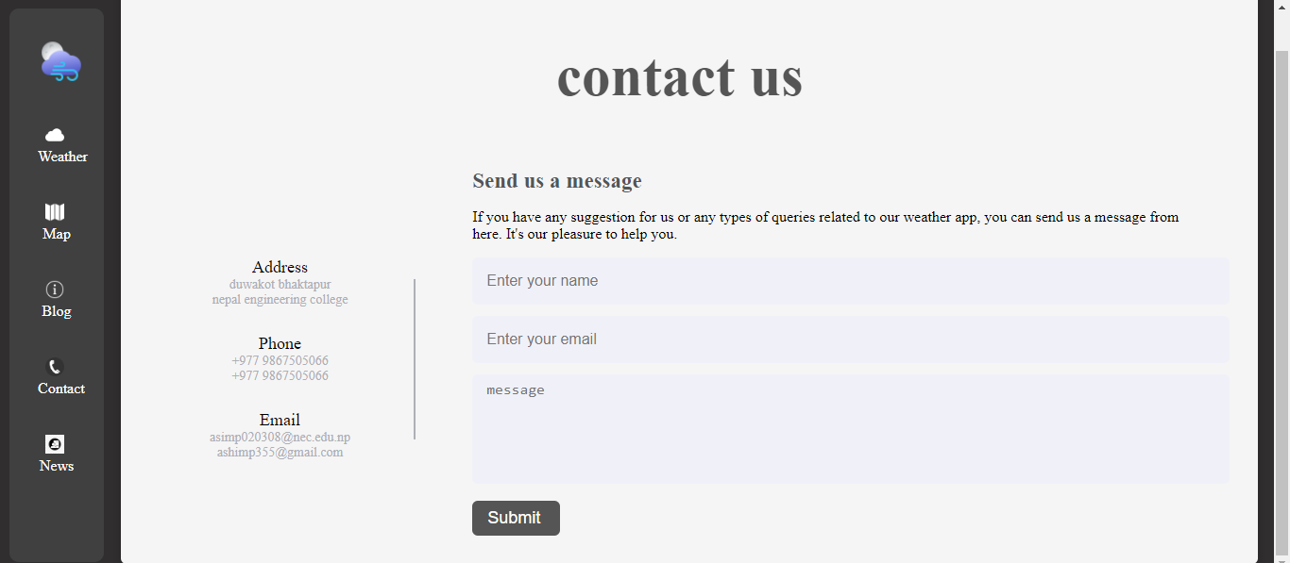

Slide 18
conclusion
Revolutionizing weather information interaction through our app.
Real-time updates, accurate forecasts, and user-friendly design.
Use of Open Weather API for enhanced accessibility.
Commitment to continuous improvement for user satisfaction and smarter daily planning.

Slide 19


